Slide 1
Mservice Care App (Beta)
Test Report

Slide 2
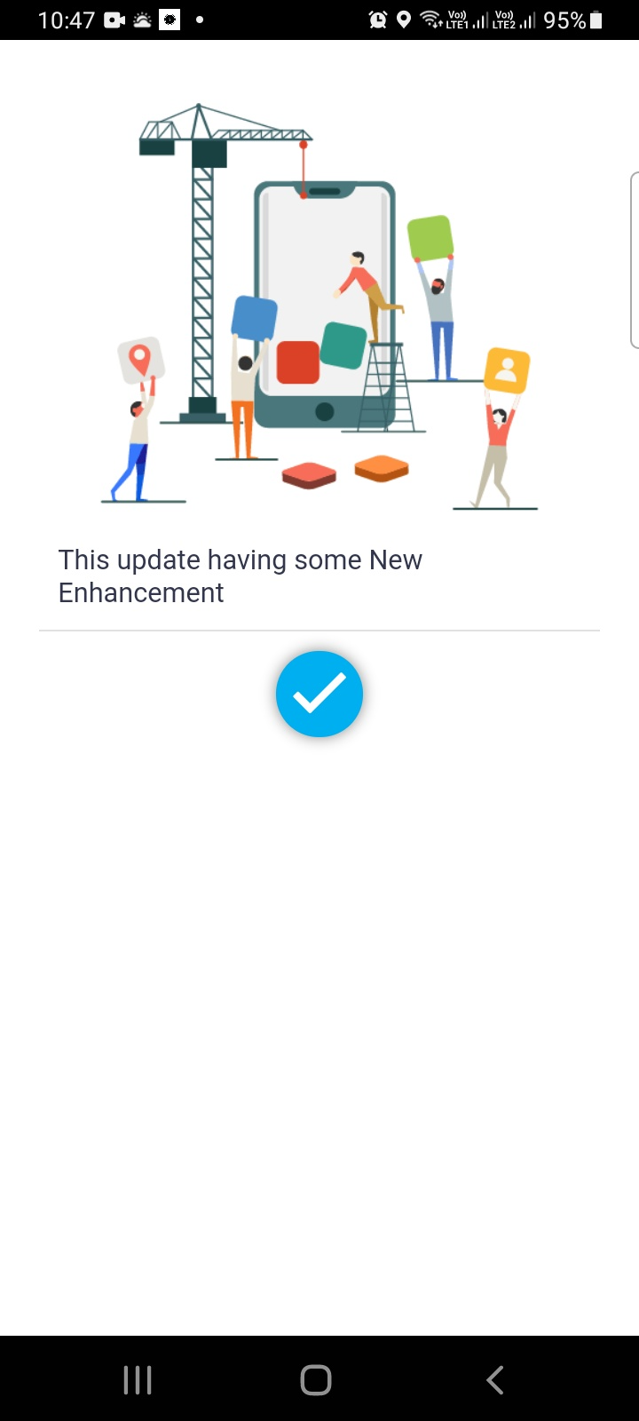
This screen is showing while reopening the app when it stopped responding & new message/attachment notification was working properly at that moment.

Slide 3
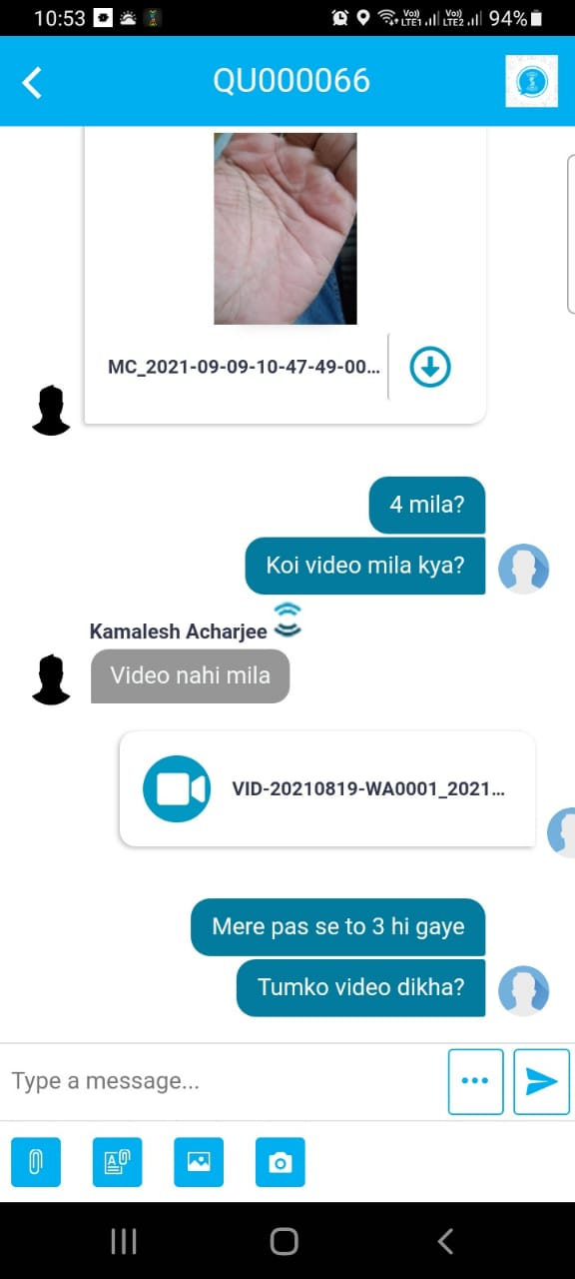
This spinner keeps on rotating when we tried to send any .mp4 video that is more than 5mb & the app stops responding at the same time. It is not showing any error message as well. And also the app is not supporting all .mp4 files.

Slide 4
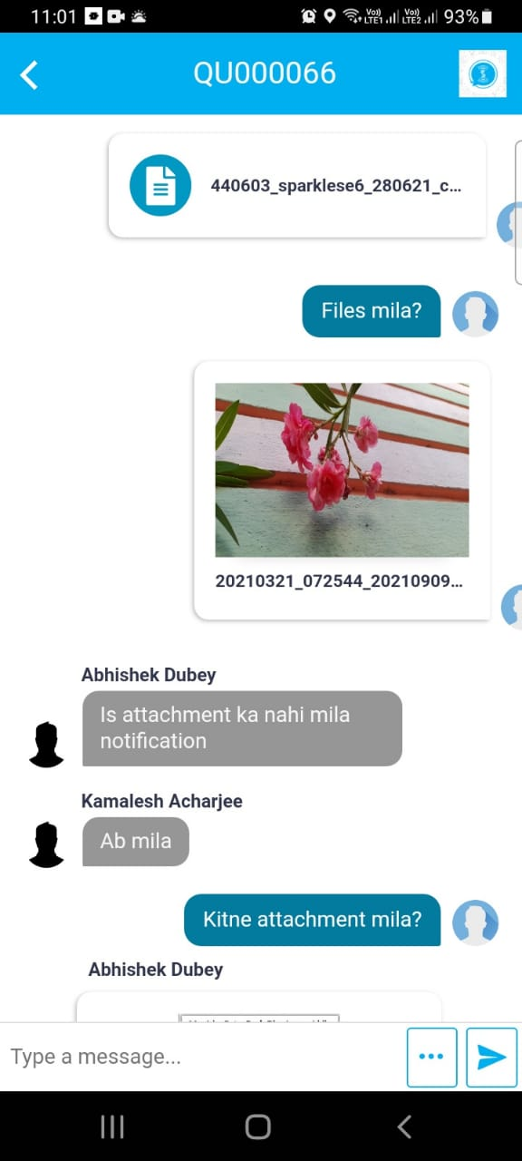
The app is showing my name instead of Abhishek in middle of a conversation

Slide 5
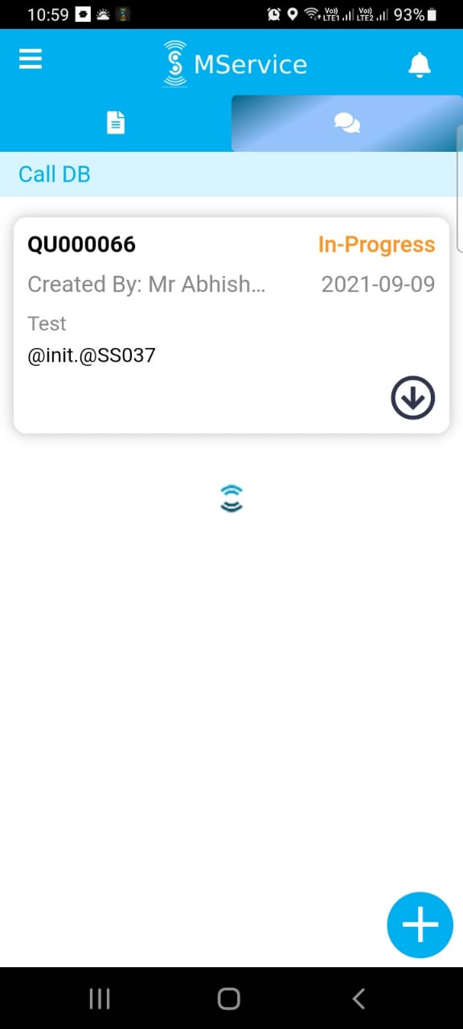
In call DB page, the spinner appeared suddenly & the app stopped responding

Slide 6
Thank You

